Slide 1
Dynamic Scheduling without Real-Time Requirements
Moiz Zaheer Malik | Hochschule Hamm-Lippstadt

Slide 2
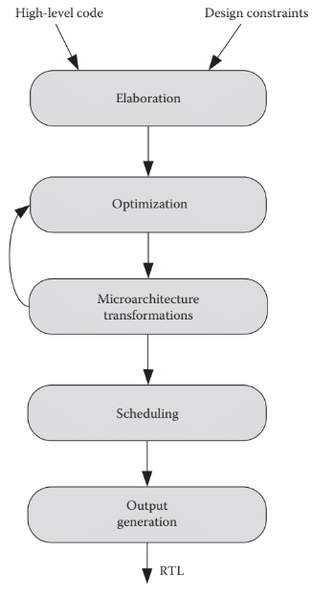
Introduction
HLS converts algorithms to hardware.
Static scheduling assigns fixed time slots (FSM).
Dynamic scheduling reacts to run-time conditions.
Useful for systems where timing isn't critical.
[4]
Referenced from: [1] [4]

Slide 3
Motivation
Why Dynamic Scheduling?
Real-time systems need exact timing, but many modern systems don't.
Multimedia, SmartPhones.
Static scheduling wastes time when tasks finish early.
Dynamic scheduling helps by responding what's actually happening
It hardware busy, improves performance, and also saves power.
Referenced from: [1] [3] [4]

Slide 4
Static vs. Dynamic Scheduling
Static: Fixed order & timing, predictable but can waste resources.
Dynamic: Tasks scheduled based on data readiness.
Dynamic allows better utilization but adds complexity.
Referenced from: [1] [2] [3] [4]

Slide 5
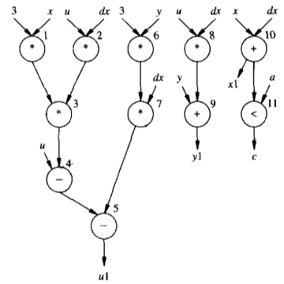
Formal Modeling
Uses Control/Data Flow Graphs (CDFG).
tj ≥ ti + di
What it means:
Operation j can only start after operation i has finished,
di is the time i takes.
Relative scheduling: operation start depends on others.
Mobility: how flexible the operation's start time is.
mobility(u) = tALAP(u) − tASAP(u)
ASAP = As Soon As Possible time ALAP = As Late As Possible time
[2]
Referenced from: [2] [3]

Slide 6
Hardware Implementation
Scheduler logic: centralized or distributed.
Arbitration units manage resource conflicts.
follow rules like priority or round robin
Referenced from: [2] [3]

Slide 7
Use Case Example
MPEG-2 decoder using self-timed pipeline.
Dynamic activation of needed blocks to save power.
Improved average performance & power savings.
Referenced from: [3]

Slide 8
Benefits & Trade-Offs
Pros: Higher performance, better utilization, power savings.
Cons: Increased hardware cost, complex verification.
Hybrid methods offer balance between both approaches.
Referenced from: [1] [3] [4]

Slide 9
When to Use Dynamic Scheduling
Best for multimedia, adaptive systems without hard deadlines.
Avoid for safety-critical systems needing strict timing.
Use hybrid when partial flexibility is okay.
Referenced from: [1] [3] [4]

Slide 10
Conclusion
Dynamic scheduling enhances flexibility and efficiency.
Needs more control logic and design effort.
Well-suited for systems without strict timing needs.
Referenced from: [1] [2] [3] [4]

Slide 11
References
[1] Ha & Teich, Handbook of HW/SW Codesign, Springer, 2017.
[2] De Micheli, Synthesis and Optimization of Digital Circuits, McGraw-Hill, 1994.
[3] Rettberg, Low Power Driven High-Level Synthesis, PhD Thesis, University of Paderborn, 2006.
[4] Scheffer et al., EDA for IC Design, Verification and Testing (2nd ed.), CRC Press, 2016.

